Slide 1
FEM updating for very flexible structures
April 2021

Slide 2
Outline
Problem definition
Introduction to numerical-only FEM updating setup
Approach:
Sequential mass and stiffness optimizations
Single-step optimization
Beam test case
Preliminary results
Limitations in SOL200

Slide 3
Numerical problem setup
Typical engineering systems use:
Physical structure with experimental data from GVT
Built-up FEM model
FEM model will not precisely match physical structure (mass, c.g., inertia, stiffness)
FEM updating seeks better agreement between actual structure and model
Achieve same setup with two FEM models:
Define a reference FEM
Perturbed FEM derived from reference (mass and stiffness properties "mistuned")
Perturbation on model properties is known, but arbitrary
FEM updating seeks minimization of differences between ‘mistuned’ version’s results compared to reference model results

Slide 4
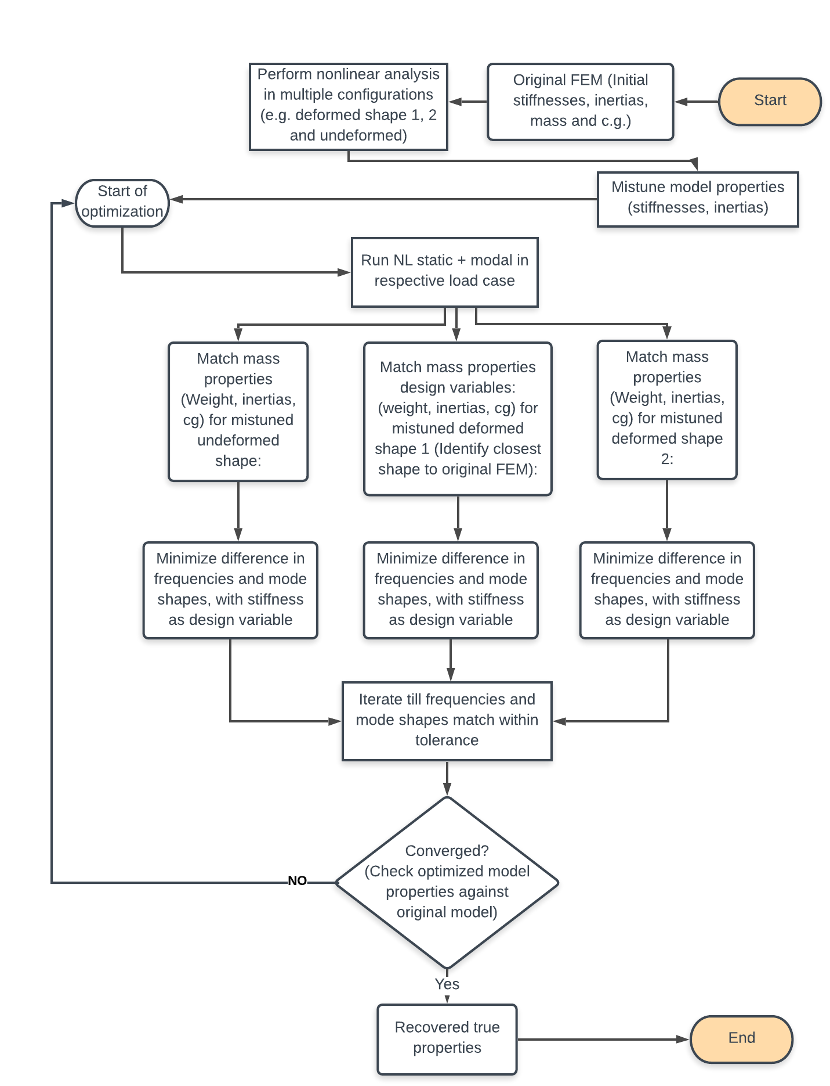
Model updating from different deformed configurations
Problem : It is currently not well known how to update FEM of VFA, particularly how to account for large deformations and how many deformed conditions are needed to fully characterize a very flexible structure
Most current structural optimization problems in literature use Nastran SOL200
Some use OpenMDAO or other (in-house) optimization frameworks
These are all for non-very flexible structures
Initial Claim/hypothesis: the reference FEM properties can be recovered from any mistuned FEM, regardless of deformed configuration (or structural flexibility)
Stage 1
Stage 2
Vary the DO, DV, DC and re-work the problem

Slide 5
Single shot optimization
N_{mistune} = n
Randomly “Mistune” properties:
mass and stiffness
Reference FEM
Extract reference values:
structural frequencies and mode shapes
Start
Multidisciplinary Optimization
For each mistuned model about a nonlinearly deformed configuration:
“Tune” both mass and stiffness properties to better correlate to reference structural frequencies and mode shapes –
two subcases, static and modal considered simultaneously
End
Recover initial reference FEM?
Vary the DO, DV, DC and re-work the problem

Slide 6
Multi-stage optimization
N_{mistune} = n
Randomly “mistune” properties:
mass and stiffness
Reference FEM
Extract reference values:
total mass, structural frequencies, etc.
Start
Optimization Stage 1:
Mass Distribution
For each mistuned model in an undeformed shape:
“Tune” mass properties to reference values:
Total mass
Center of gravity location
Optimization Stage 2:
Stiffness Distribution
For each mistuned model, apply load and obtain nonlinear static deformation:
Deformed modal analysis: “Tune” stiffness properties to better correlate to reference structural frequencies and mode shapes (from the same loading condition)
End
Recover initial reference FEM?
Vary the DO, DV, DC and re-work the problem

Slide 7
Two-stage optimization (version 1)
Stage 1: Mass Optimization
Configuration: undeformed
Analysis/solver: none (or dummy)
Obj: minimize weighted differences in total mass and c.g. location
DVs: material density and concentrated mass values + locations
DCs: side constraints
Stage 2: Stiffness Optimization
Configuration(s): nonlinearly deformed
Analysis/solver: modal
Obj: minimize differences in modal frequencies
DVs: material and element stiffness, BCs
DCs: MAC > 0.9 for subset of mode shapes and side constraints
Outcome: compare each optimized configuration's undeformed modal analysis with reference

Slide 8
Two-stage optimization (version 2)
Stage 1: Stiffness Optimization
Configuration(s): nonlinearly deformed
Analysis: static
Obj: minimize differences in deformed shapes
DVs: material and element stiffness, BCs
DCs: side constraints
Stage 2: Mass Optimization
Configuration: nonlinearly deformed
Analysis: modal
Obj: minimize differences in modal frequencies
DVs: material and concentrated mass properties
DCs: MAC > 0.9 for subset of mode shapes and side constraints

Slide 9
One-shot optimization
Mass + Stiffness Optimization:
Configuration: nonlinearly deformed
Analysis: nl static + modal
Obj: minimize differences in modal frequencies and mode shapes
DVs: mass (and inertia) + concentrated mass properties, stiffness properties, BCs (suspension or )
DCs: MAC > 0.9 for select subset of mode shapes
Side constraints

Slide 10
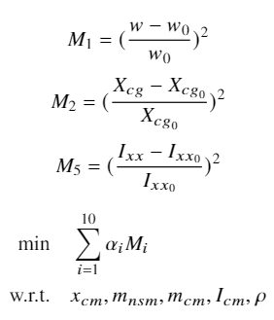
Mass-matching objective
Design Variables
Material density
Concentrated mass properties
Objective function
Sum of the weighted squares of relative error in structural weight and CG locations
Constraints
Must have some constraints, side constraints on DV
Optimizer is going to find some way to satisfy problem by exploiting any weakness – accommodate for that

Slide 11
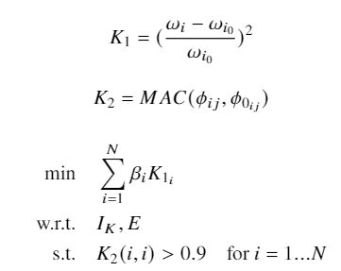
Frequency-matching objective
Design Variables
Material (E) and element (I) stiffnesses properties, BCs
Objective Function
Sum of the weighted squares of relative error in modal frequencies
Constraints
MAC value of mode shapes greater than specified tolerance
Side constraints (UB/LB) on DV

Slide 12
Deflection-based objective
Design variables
Stiffness or dimensions of structure (E or I)
Objective function, two options used
Square of perturbation in deflection
Square of perturbation in structural dimension(s)
Constraints
Constrain beam deflection if not present in objective function

Slide 13
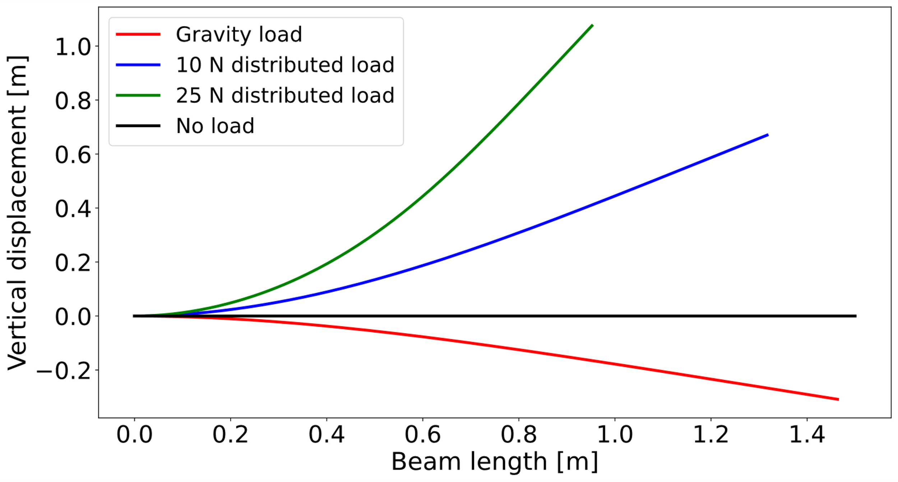
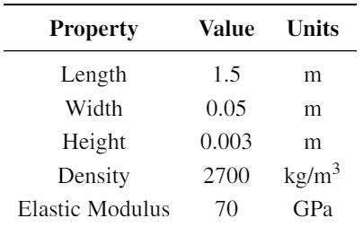
Beam test case
Reference FEM Model:
150 beam elements
Subdivided into 15 regions for "mistuning“
Can change BC – does that add anything?

Slide 14
MSC Nastran SOL 200
Gradient-based optimization toolbox
Default optimizer: modified method of feasible directions
Unconstrained minimization methods
Steepest Descent
Conjugate gradient
KKT conditions for optimality for constrained minimum
SLP - Sequential linear programming
linearize
solve linear problem using simplex or another optimizer
Re-linearize and repeat till convergence
SQP also available
LIMITATIONS –
nonlinear structural solver not available inside optimizer
Subcases handled at once – no steps (i.e., cannot do a deformed modal analysis directly)
This also means that multi-objective (like frequencies matching + static deflection matching) cannot be handled in the same input file (or objective function) since that calls for having both static and modal results accessible and the optimizer only has access to one solver results in each subcase
must define a series optimization problem to do this - problematic

Slide 15
Mistuning – FEM property perturbation
Python script:
User specifies how many perturbed models they want output
User specifies "mass", "stiffness", or "both"
User specifies how many perturbations to perform
Reads in a reference .bdf file
Randomly perturbs properties within a set range (5%)
Saves the mistuned .bdf
Perturbations applied to regions of the FEM

Slide 16
Results of mass matching
Note: The ‘section’ in the second plot is misleading since it shows the overall average across the entire structure

Slide 17
Setup and results of stiffness tuning

Slide 18
Literature Review
Selected papers – add a quick list here of the paper titles, year and where they were published

Slide 19
Paper 1: Overview
Jin, S. S., Cho, S., Jung, H. J., Lee, J. J., and Yun, C. B., “A new multi-objective approach to finite element model updating,” Journal of Sound and Vibration, Vol. 333, No. 11, 2014, pp. 2323–2338
Compares single-objective function (SOF) vs multi-objective function (MOF) approach in forming the FEM updating optimization problem
Outlines SOF and MOF formulation and applies to experimental problem featuring a highway overpass bridge

Slide 20
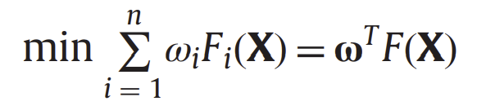
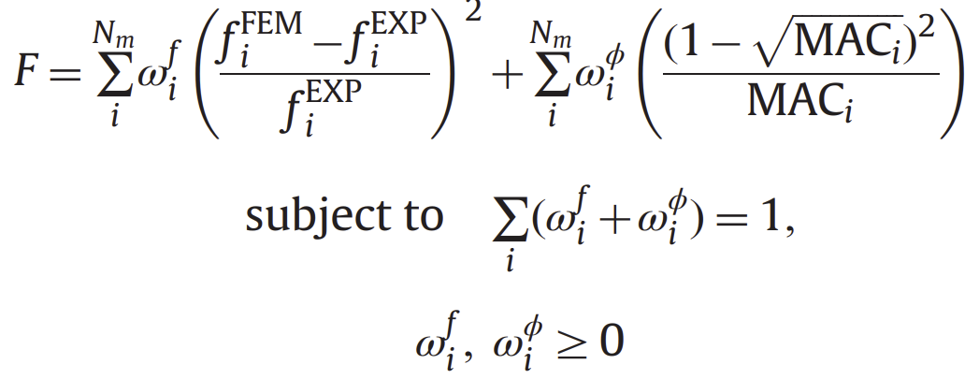
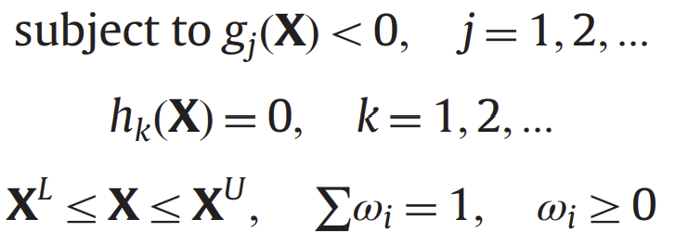
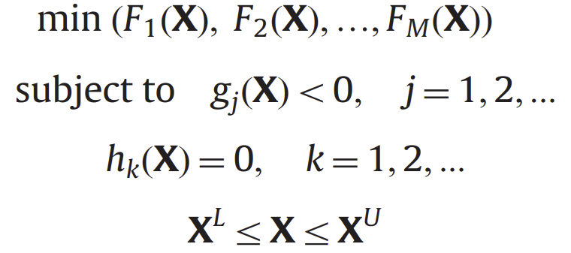
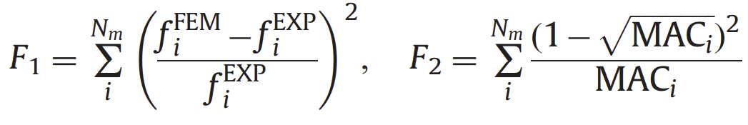
Paper 1: Formulation
SOF:
MOF:
F – objective functions
X – design variables, can have side constraints
g – inequality constraints
h – equality constraints
w – weights, determined by user
MOF eliminates need for user to set w
Only side constraints used in demonstration problem

Slide 21
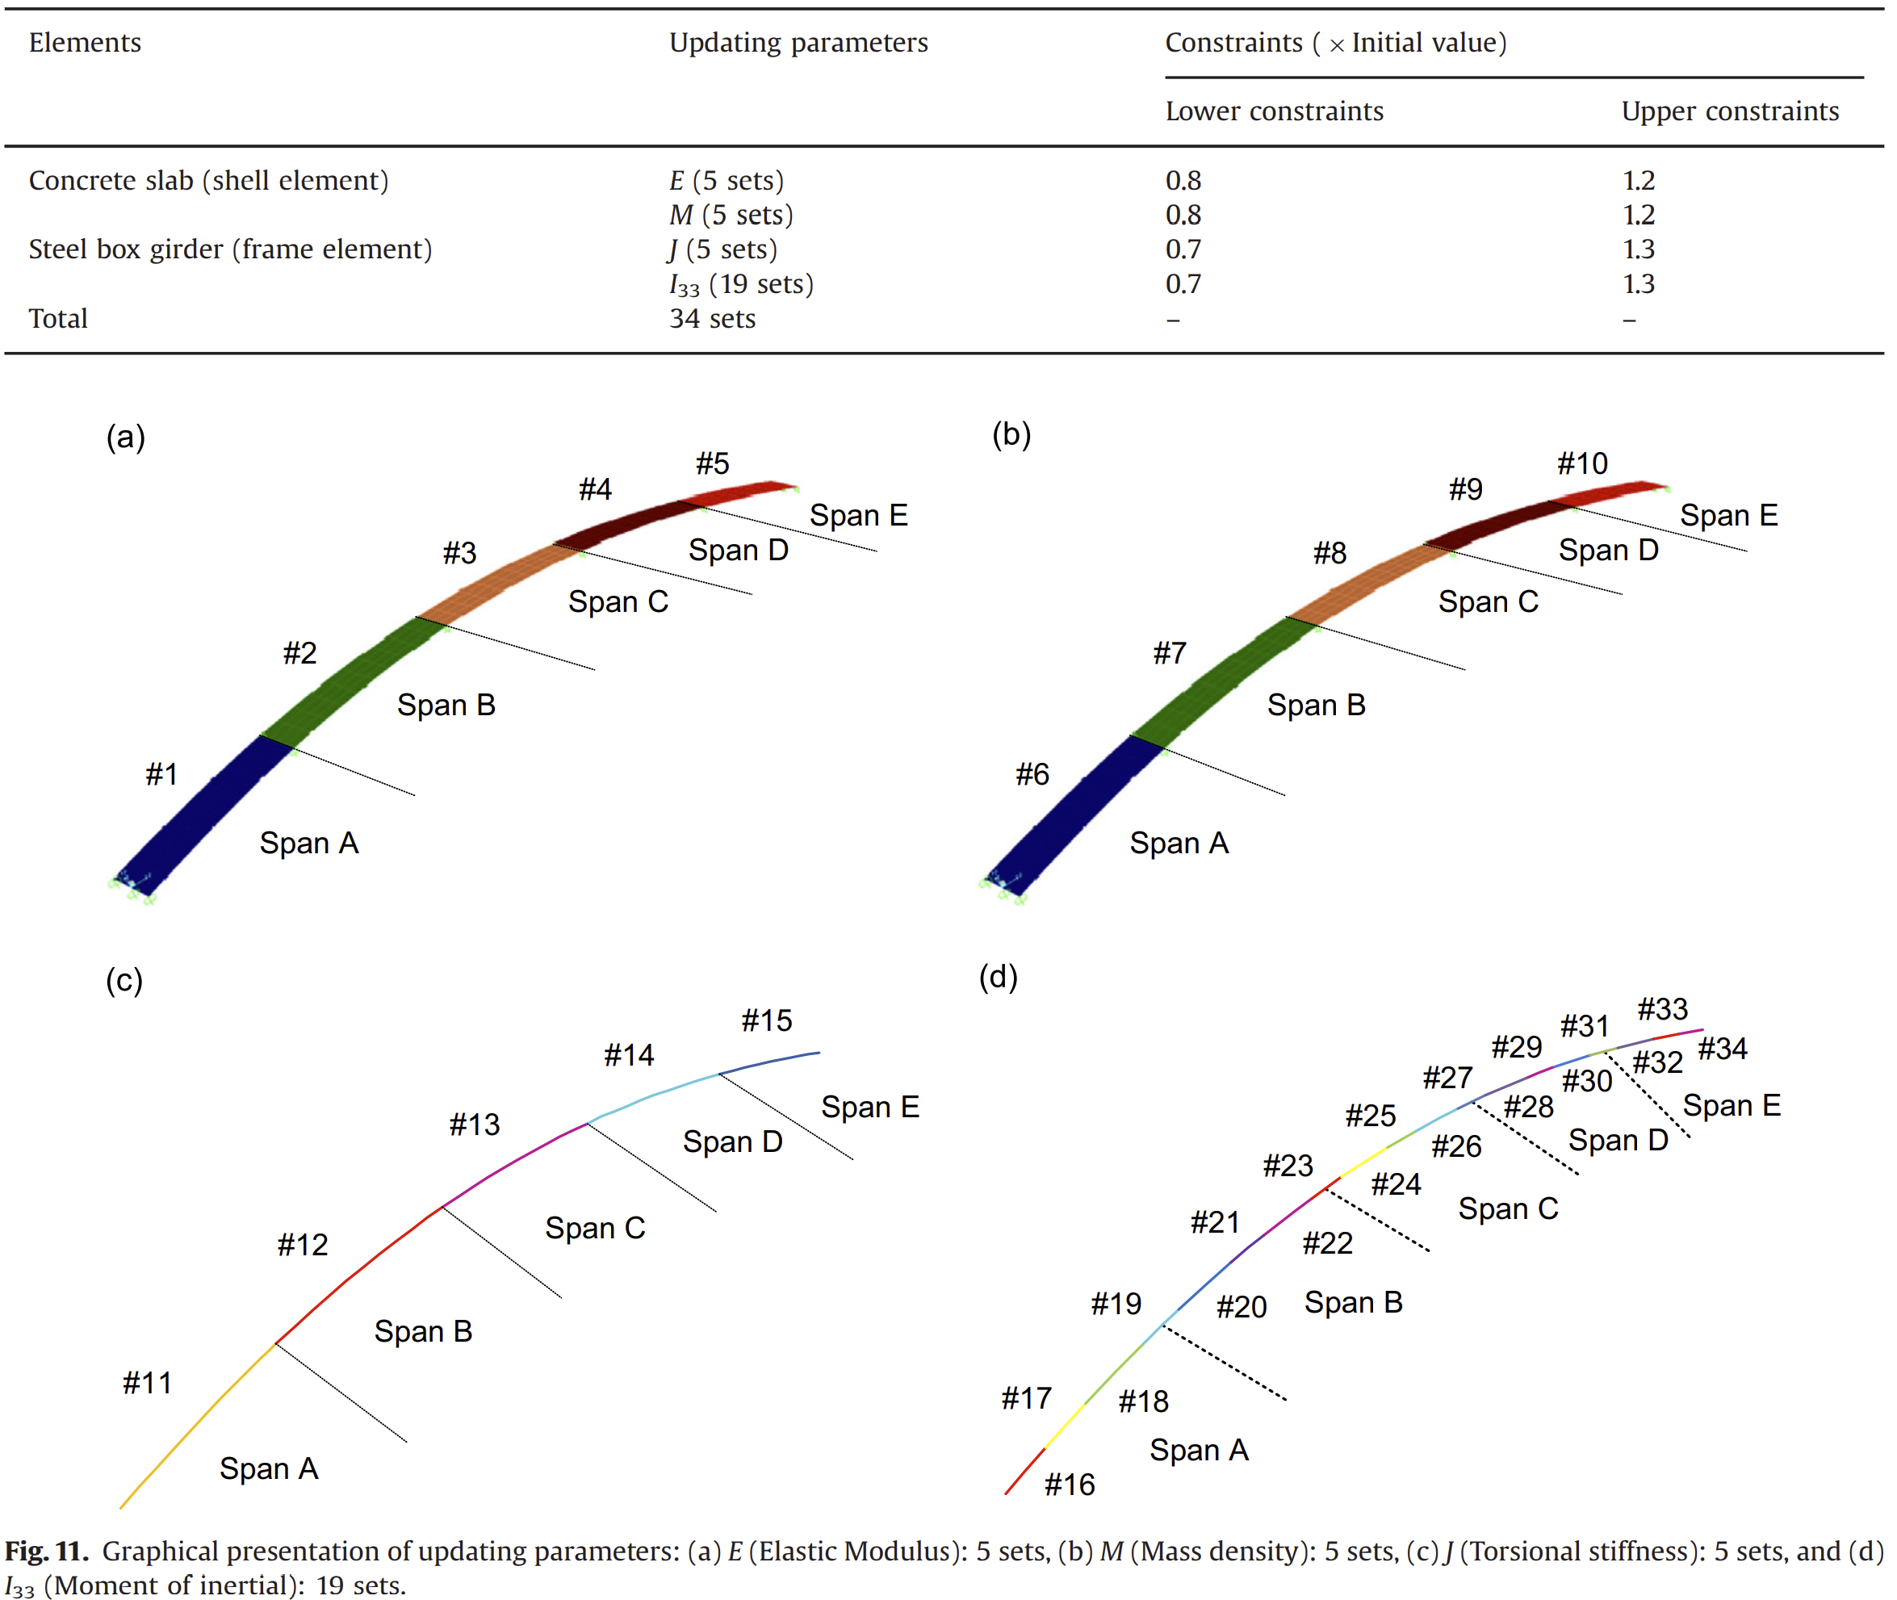
Paper 1: Implementation
Optimizer:
SOF – Genetic Algorithm
MOF – Non-dominating Sorting Genetic Algorithm-II (NSGA-II)
FEM Solver:
SAP2000 (civil FEM program)
Interfaced through GUI within MATLAB
Test Case:
Highway overpass bridge
14 accelerometers measured first 6 natural frequencies + modeshapes used as reference
Segments FEM into multiple regions to keep problem size small since using gradient-free optimizer

Slide 22
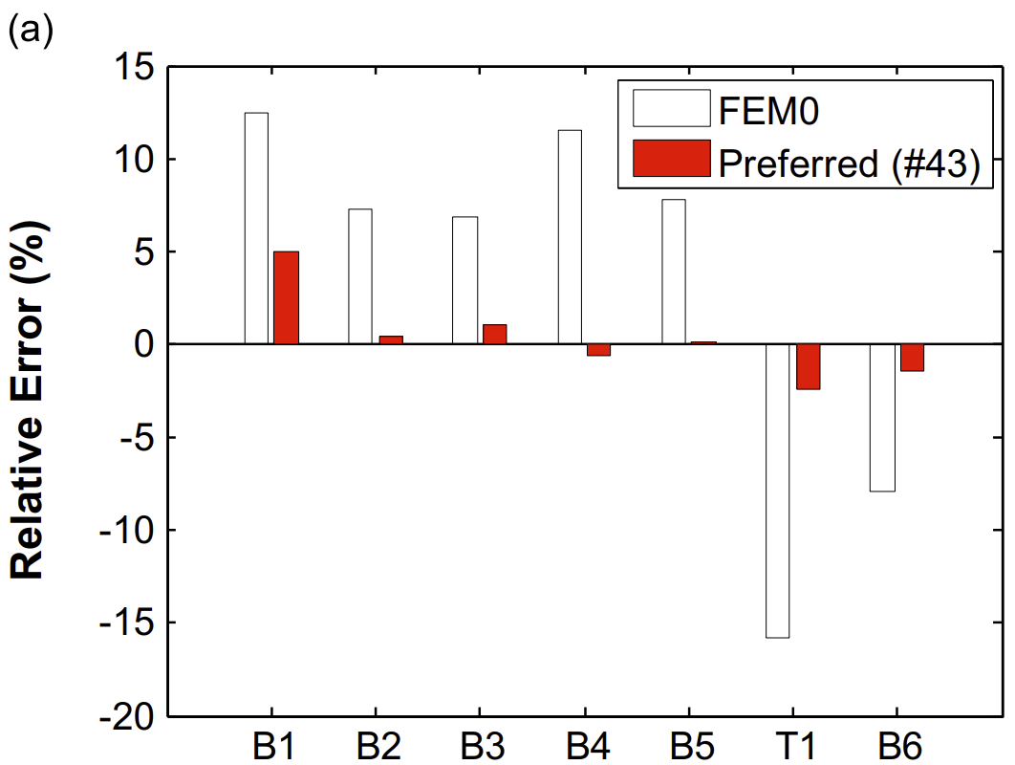
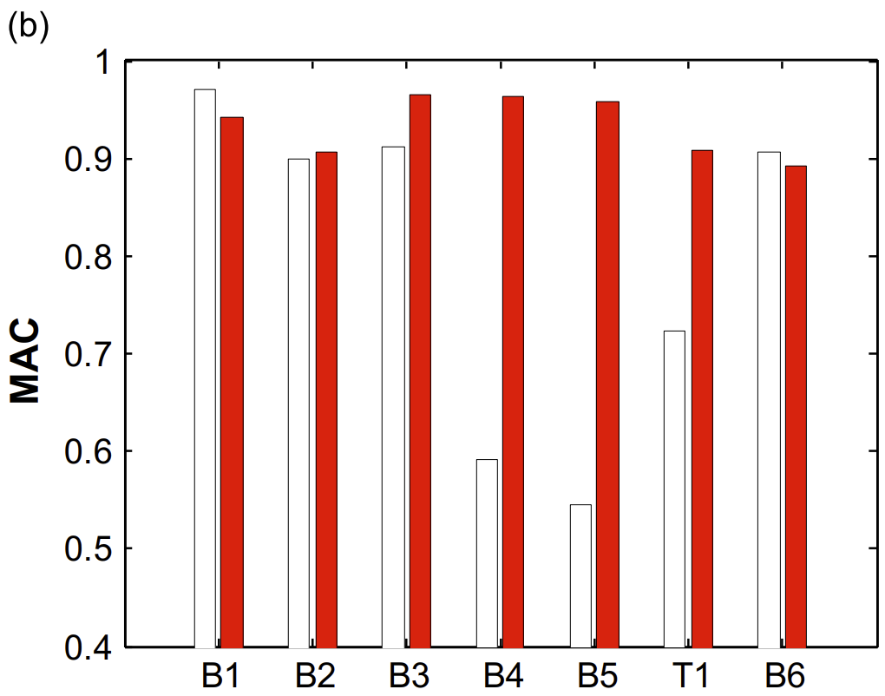
Paper 1: Outcomes
MOF shows automated convergence and generation of Pareto front for the two objectives
MOF “global” optimum showed better agreement to experimental data compared to SOF
MOF required orders of magnitude fewer function evaluations and computational time

Slide 23
Paper 2: Overview
Holmberg, E., “FE-Model update after GVT of a Gripen E test aircraft,” International Forum on Aeroelasticity and Structural Dynamics 2019, IFASD 2019, 2019
Applies optimization technique to update a large built-up FEM model of a fighter aircraft considering multiple configurations (pylons/stores)
Utilizes Nastran SOL 200

Slide 24
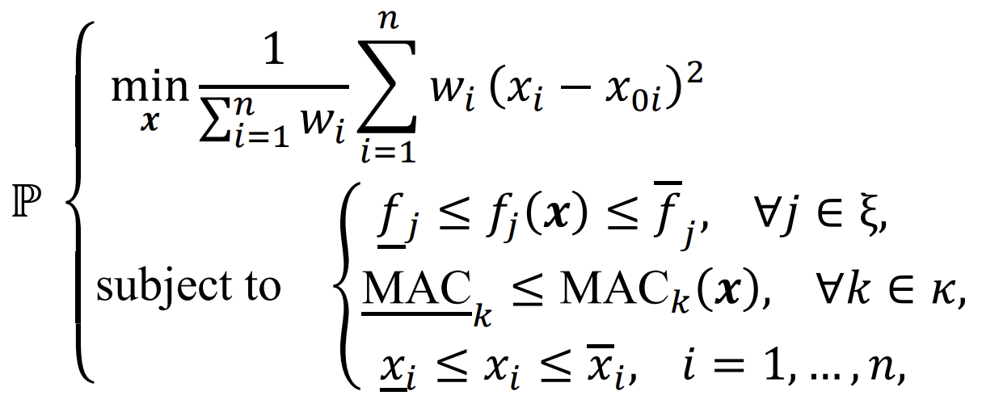
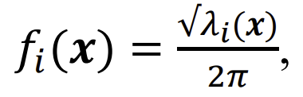
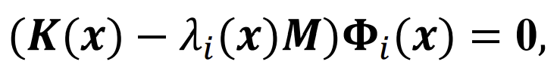
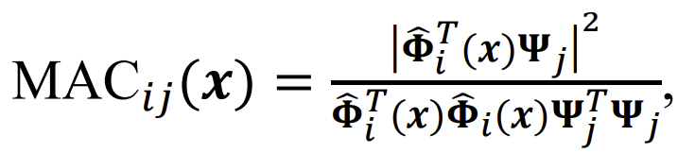
Paper 2: Formulation
Assumes initial FEM model is close to experiment a priori
Seeks to minimize (weighted) changes to design variables
Subject design vars to constraints on frequency and MAC along with side constraints
Only stiffness properties are considered, mass matching done a priori
Material moduli and additional spring stiffnesses chosen as design variables
Weight factors used to compensate for the geometrical size of the region a design variable affects (more elements = more expensive)
Constraint bounds chosen separately for each constraint

Slide 25
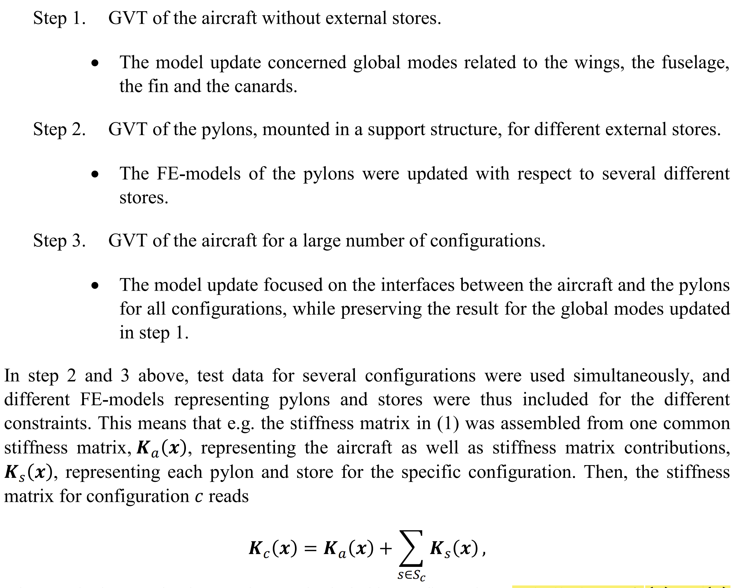
Paper 2: Implementation
Mass and c.g. of FEM tuned using non-structural masses to match measured values for each configuration prior to optimization
Different parameterizations were tested and used at different stages in their updating procedure
Identified regions based on strain energy plot for select modes, among other methods
Nastran SOL 200 with MultiOpt Optimization option used for considering multiple configurations in a single problem
MATLAB scripts used for generating input files (writing design variable definitions, constraint and objective functions, etc.)
Additional scripts developed for post-processing files and extracting data for plotting
3-step approach, step 1 does a global update, steps 2 and 3 consider multiple store/pylon configurations, continuing to update the model

Slide 26
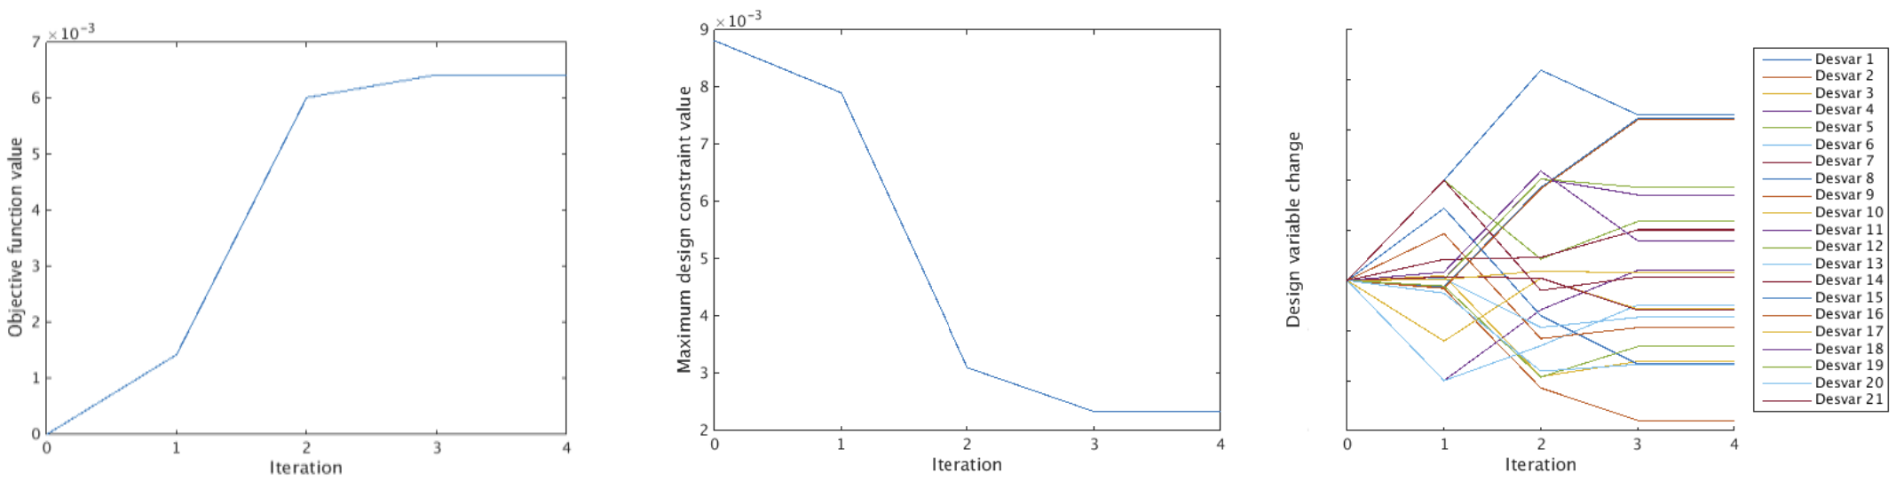
Paper 2: Outcomes
Optimization considering multiple configurations converges in just a few iterations
Objective function increases as constraints are initially violated
For each configuration, vast majority of frequencies and modeshapes see improvements or held steady with low error
Few instances where the MAC constraints needed to be set very low

Slide 27
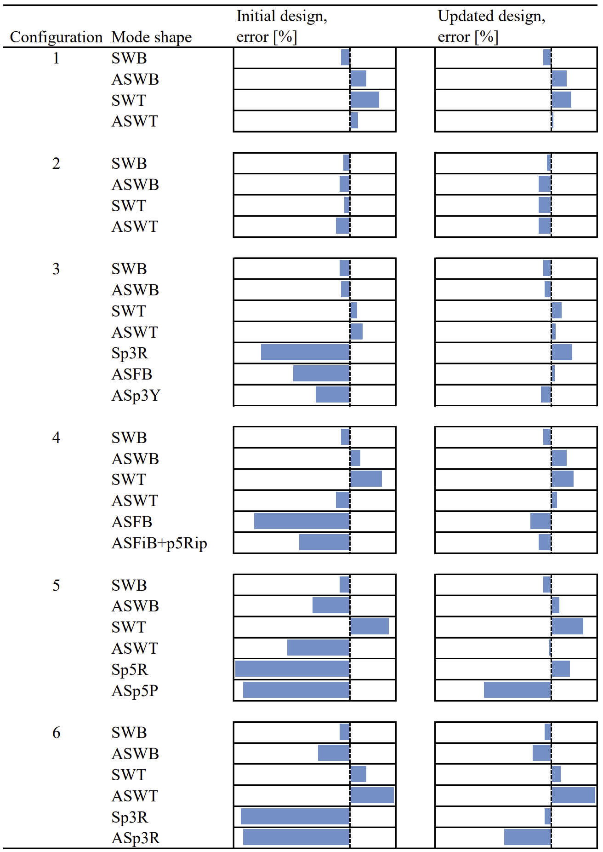
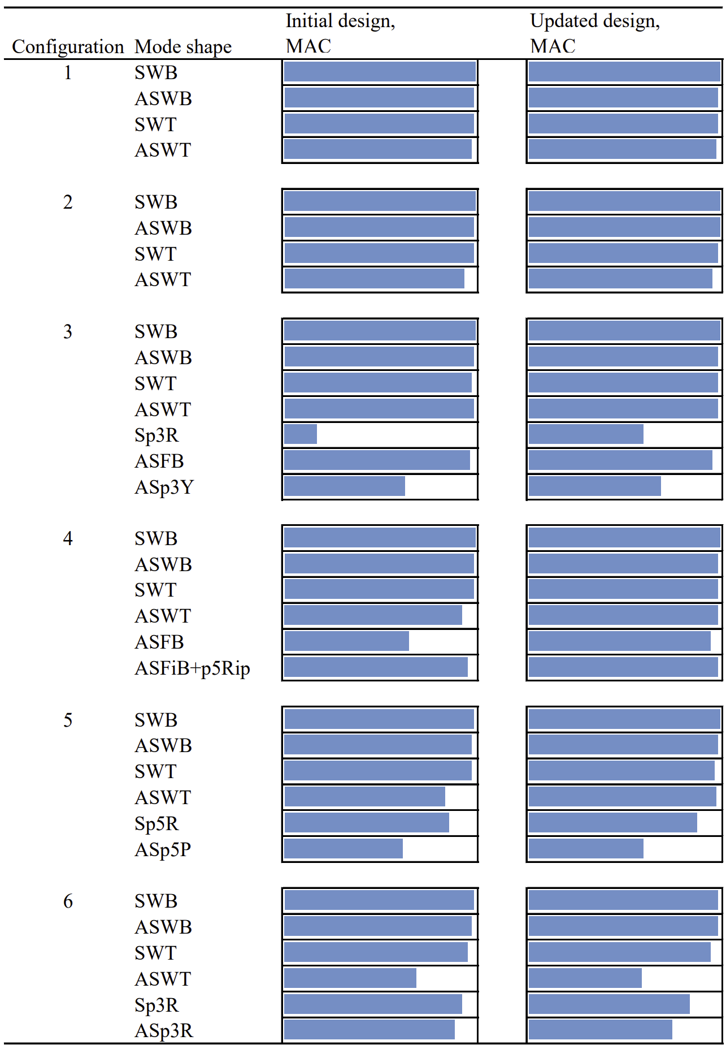
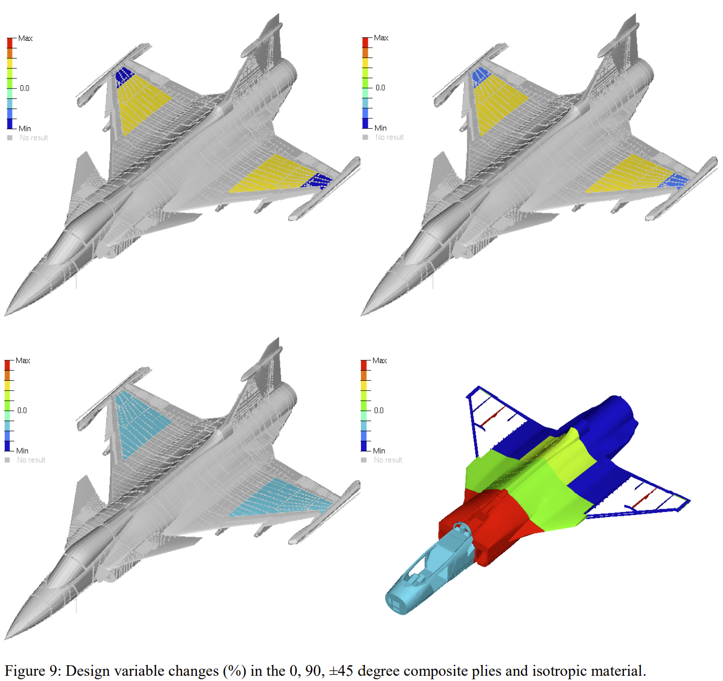
Paper 2: Outcomes

Slide 28
Paper 3: Overview
Prananta, B., Kanakis, T., Vankan, J., and Van Houten, R., “Model updating of finite element model using optimisation routine,” Aircraft Engineering and Aerospace Technology, Vol. 88, No. 5, 2016, pp. 665–675. doi:10.1108/AEAT-02-2015-0064
Applies optimization technique to update a beam FEM model of a small general aviation aircraft
Utilizes Nastran SOL 200

Slide 29
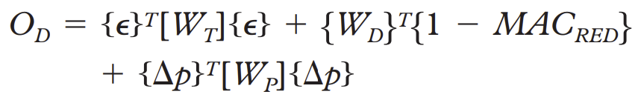
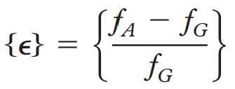
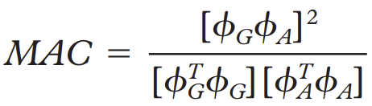
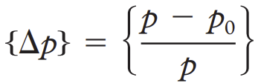
Paper 3: Formulation
Assumes initial FEM model is close to experiment a priori
Objective seeks to reduce error in frequencies, with weighted penalties on MAC values and changes to properties
Only side constraints are used
A reduced MAC is evaluated for the objective using a few key nodes, not the full nodal vector
Authors claim that mass properties are better known, so only stiffness parameters are considered as design variables
Parameter grouping shown to result in nearly same performance with large reduction in computational effort/time
Authors recommend use of sensitivity study done so only the most sensitive parameters are used as design variables to keep problem size as small and effective as possible
Authors propose that different values of weights be used to conduct a multi-objective problem for minimizing error in frequency and MAC

Slide 30
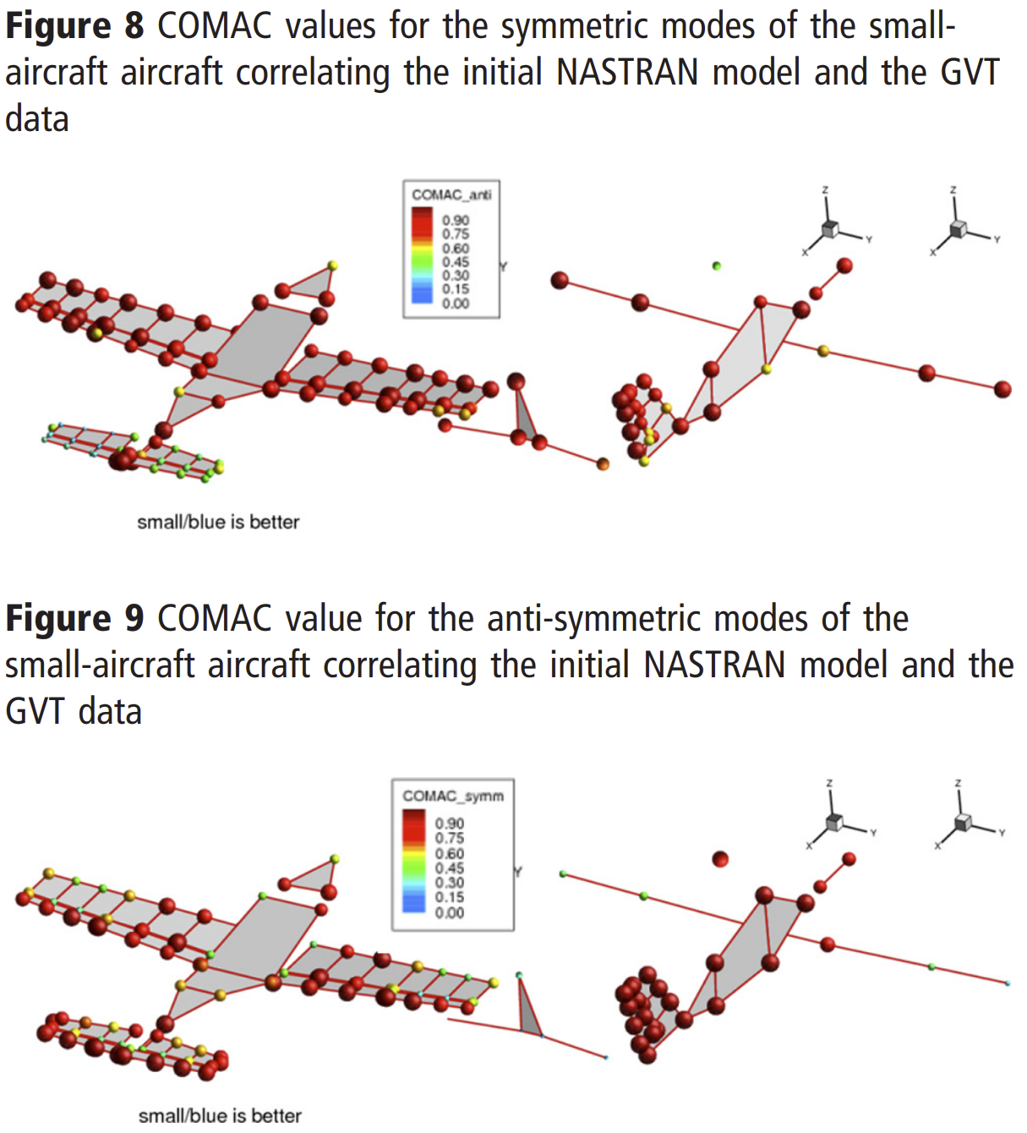
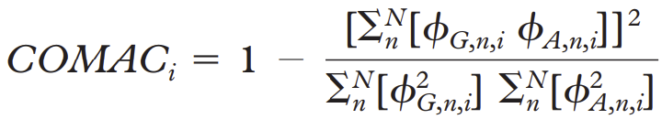
Paper 3: Implementation
NASTRAN SOL 200 used, where various boundary conditions are applied to the model as sub-cases to achieve symmetric and anti-symmetric modes
RBE3 elements used to connect to accelerometer location from GVT to the beam FEM structure
After initial comparison of FEM to GVT, a COMAC method is used to see if error is localized to specific nodes or regions in the model, in addition to parameter sensitivity study to determine which parameters should be used for updating
Design parameters consist of material elastic moduli, bending and torsional beam stiffnesses, and scalar spring stiffness properties
Authors do not discuss any kind of pre/post-processing scripts for the optimization problem

Slide 31
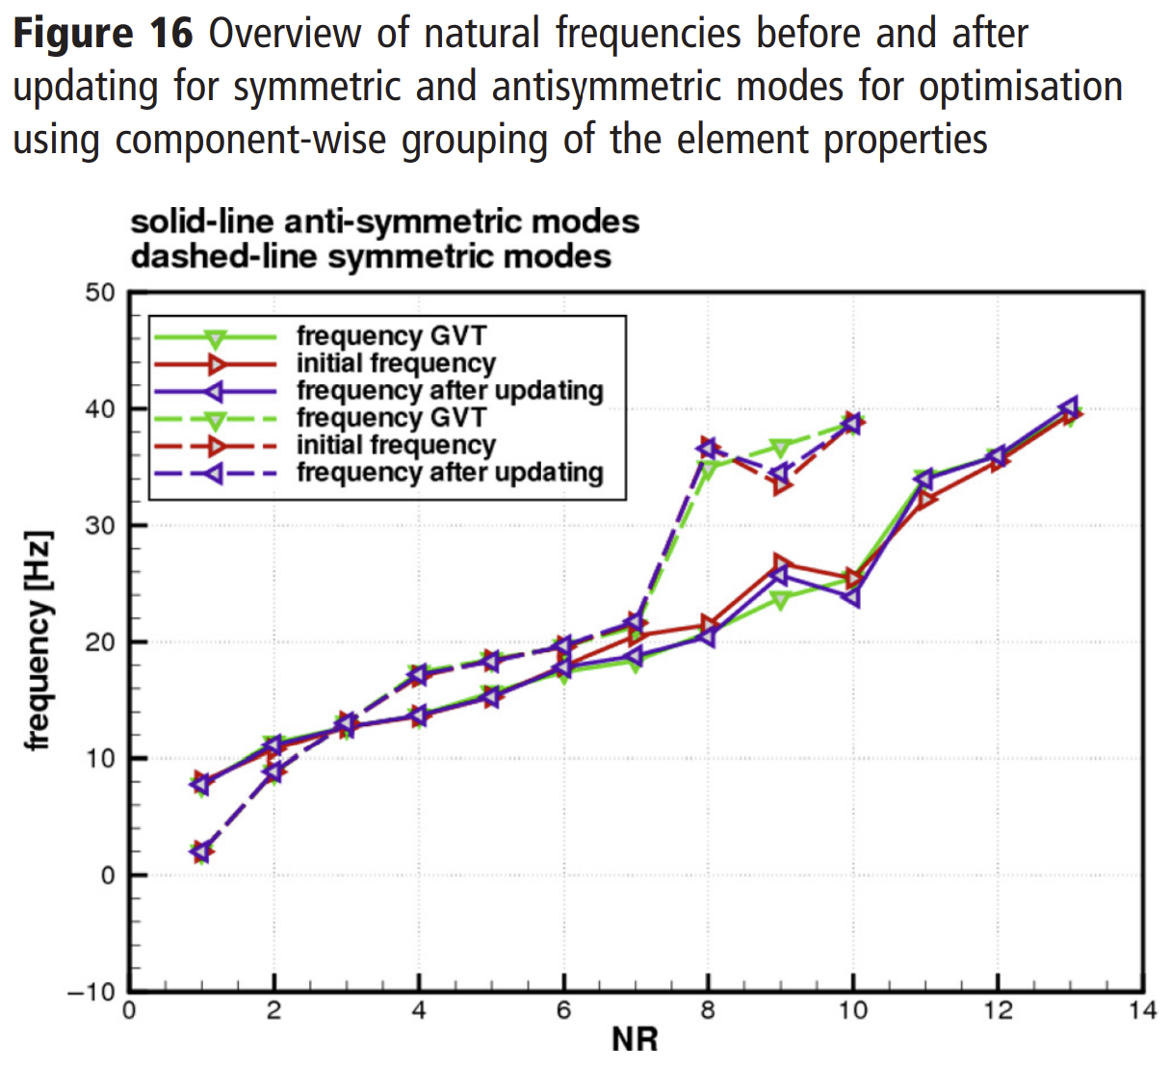
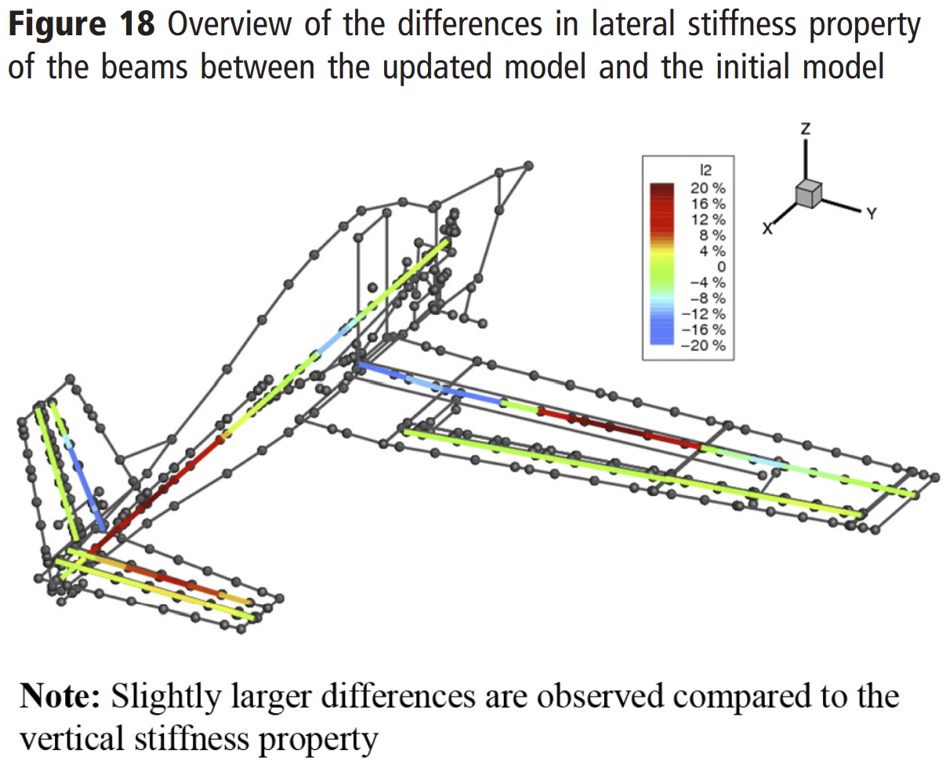
Paper 3: Outcomes
Optimization using grouped parameters showed nearly the same results, reducing problem size from 800 design variables to 48, reducing computational cost by 90%
Results showed the average relative error in natural frequencies reduce from 3.8% to 1.4% for anti-symmetric modes and 1.9% to 1.5% for symmetric modes
Nearly all frequencies are improved or maintained with low error, but MAC comparisons are more variable
Authors only tested a single set of weighting parameters and suggest testing with more to form a multi-object problem
Authors also only tested with one small set of nodes for the reduced MAC evaluation and suggest testing more

Slide 32
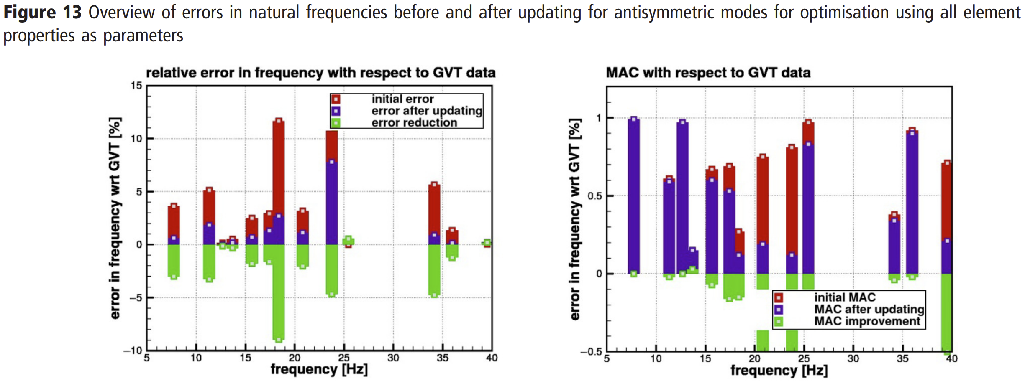
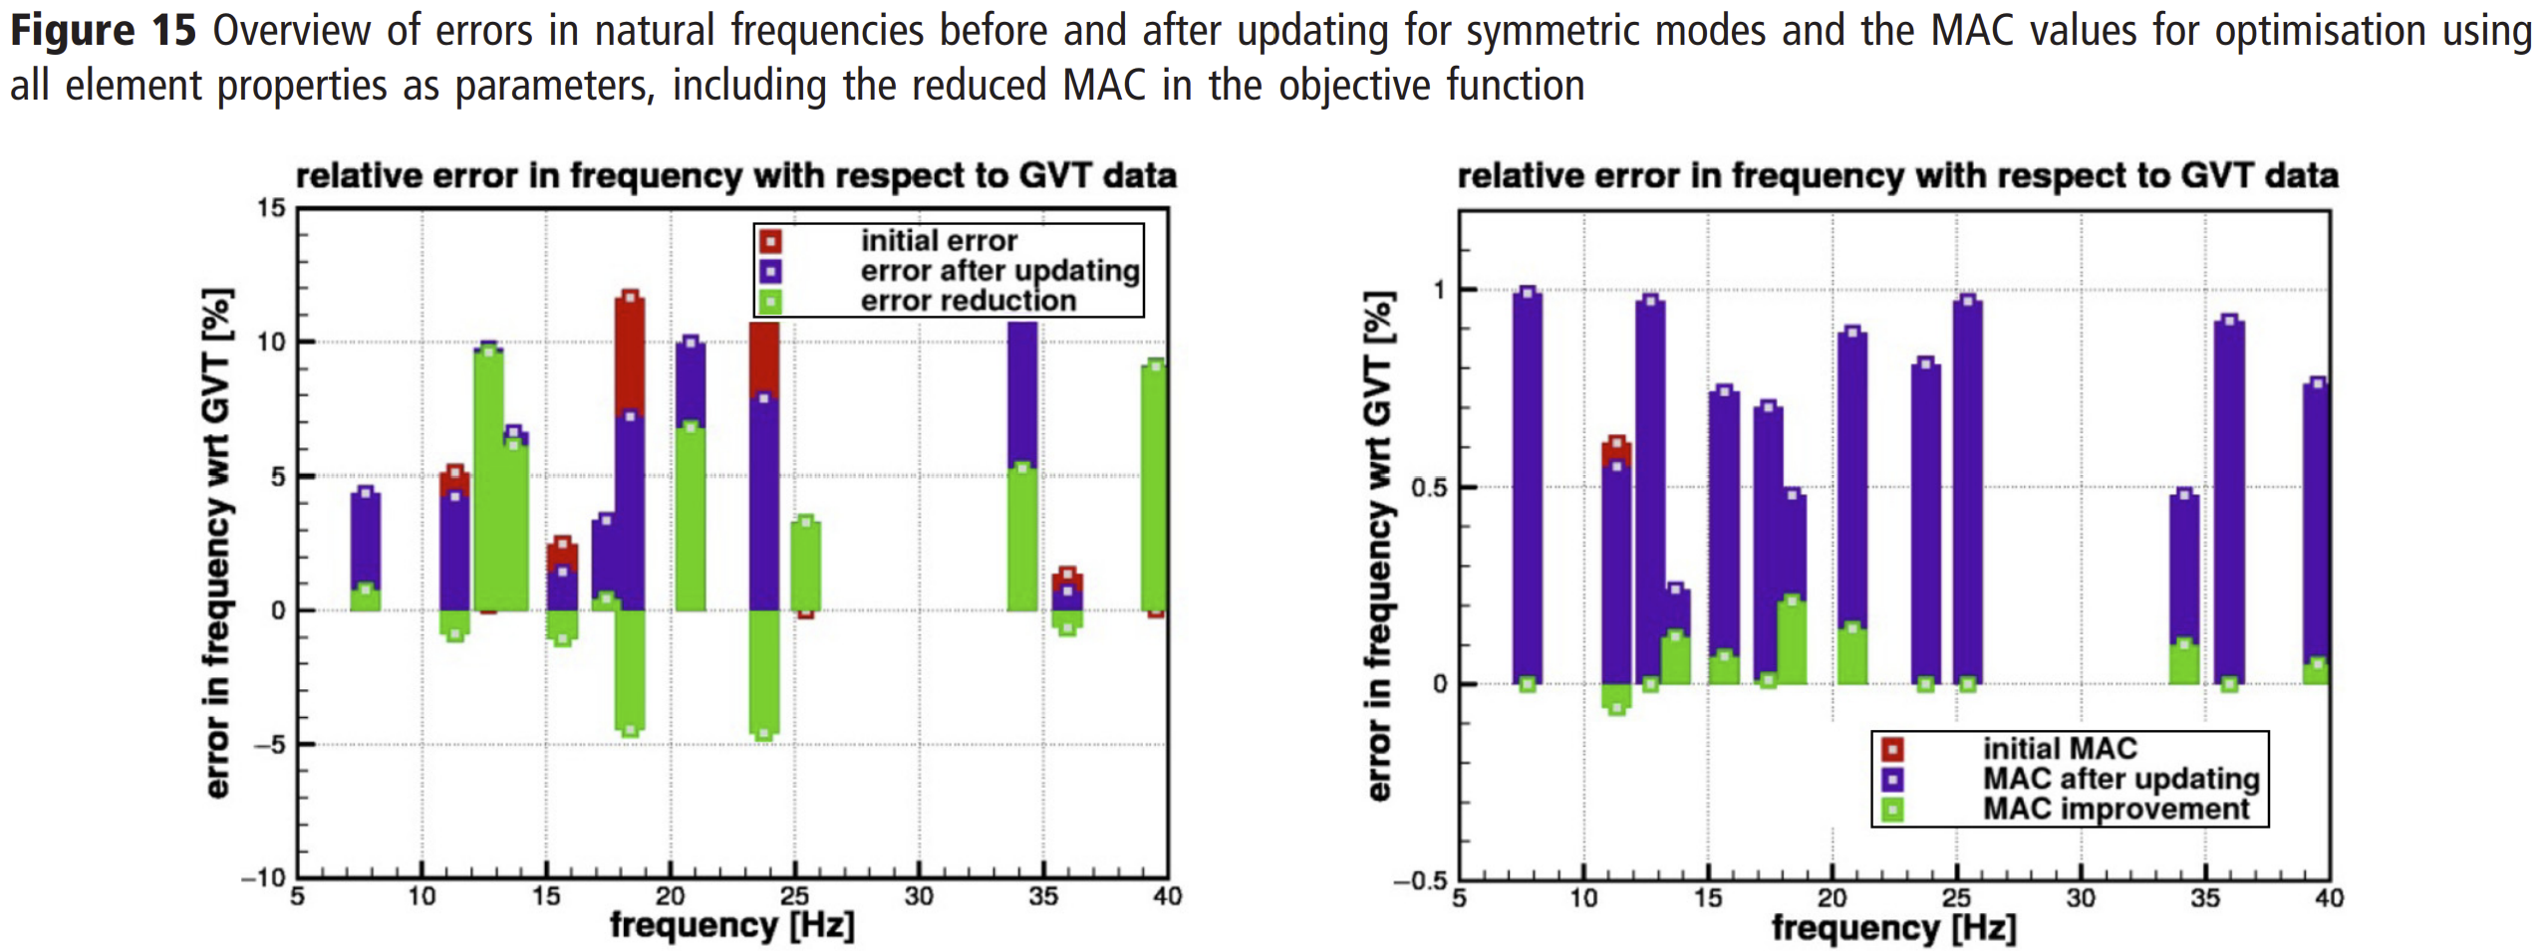

Slide 33
Paper 4 Overview
Creating a Test-Validated Finite-Element Model of the X-56A Aircraft Structure
Chan-gi Pak and Samson Truong
Journal of Aircraft 2015 52:5, 1644-1667
Note: Add a picture of the structure
Overview:
Used proprietary tool based on an early version of OpenMDAO and built upon a previous paper that described the ground vibration test and model tuning procedures for the second aerostructures test wing (ATW2)
They developed a process where user will choose an optimization algorithm, define the continuous as well as the discrete design variables with side constraints, starting values, and scaling factors; and provide script and data file names for each performance index.
Communication between the O3(object-oriented optimization) tool and each analysis sub-module will be performed by design variables and performance indices.
Once the O3 tool is executed, design variables will be created and saved in an external data file. This data file cannot be shared with other analysis submodules;
and therefore, a script command will make a copy of this data file first. Script commands for each performance index will perform the following tasks
prepare data for analysis program (pre-processor module);
submit analysis job (analyzer module); and
read result files, compute the required performance index value, and save it (post-processor module)

Slide 34
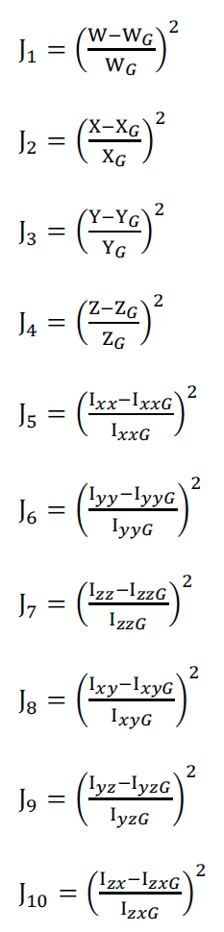
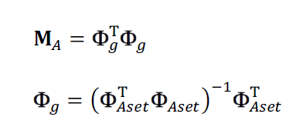
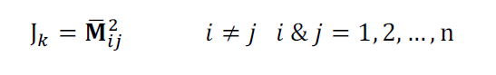
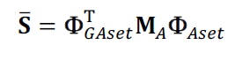
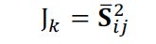
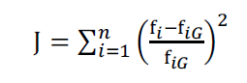
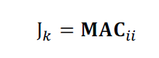
Paper 4 problem formulation
Weight Sub-module
Mass Orthogonality Sub-module
Frequency Sub-module
Mode Shape Sub-module
Modal Assurance Criteria Sub-module
Note: Submodules defined based on satisfying NASA and MIL standards – definition provided in previous papers
Note: Add the formulation of the optimization problem
Identified ‘primary and secondary modes’ using modal participation factor obtained from a flutter analysis of the model
Defined four model tuning rounds using different primary and secondary modes and two different mass configurations

Slide 35
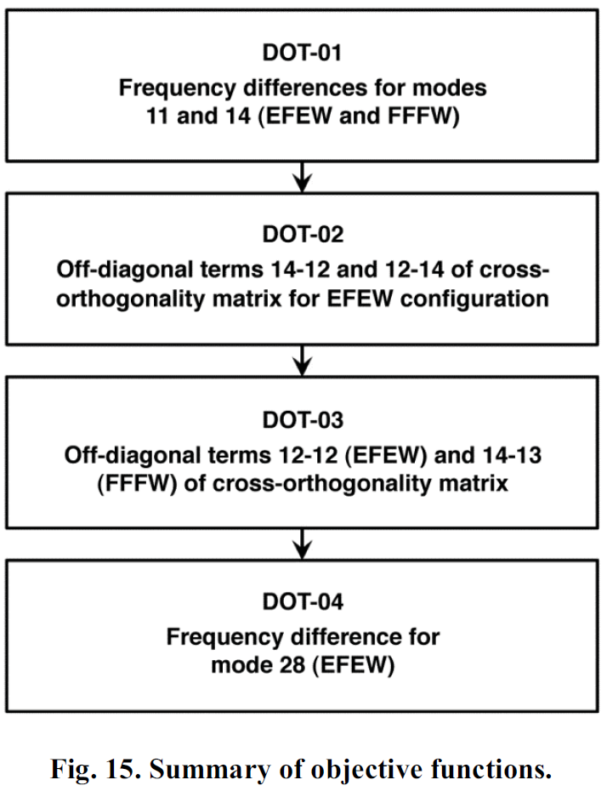
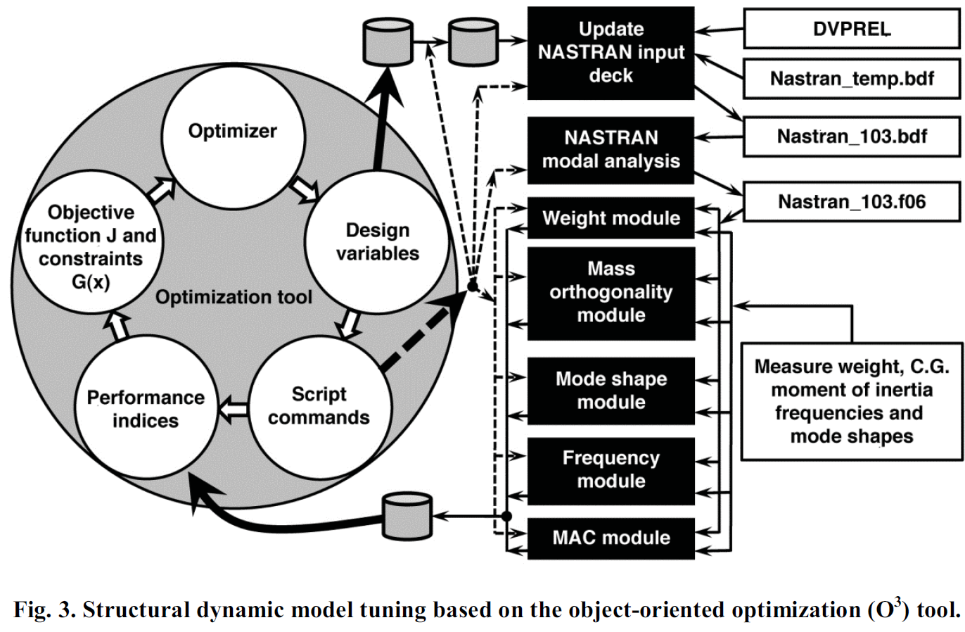
Paper 4 implementation
Notes:
NASA AFRC has developed a computer code for FE model tuning using the Object-Oriented Optimization (O3) tool together with Nastran, a FE analysis computer software program. Three optimizer algorithms have been incorporated into the O3 tool: design optimization tools (DOT) based on a gradient-based algorithm, the genetic algorithm (GA), which is a class of stochastic and global optimization, and big-bang big-crunch algorithms

Slide 36
Paper 4 outcome/conclusion
Model tuning of the aircraft performed in stages, starting with tuning of the frequency, followed by the cross-orthogonality (mode shape) matrix.
A total of four structural dynamic model tuning runs were conducted focusing on the improvement in frequency errors and the off-diagonal terms of the cross-orthogonality matrices for both the EFEW and the FFFW configurations of the X-56A aircraft in a single optimization run.
Other properties such as weight of GVT sensor cables, total weight, CG location, and off-diagonal terms of the orthogonality matrix were primarily used as constraints as the current configurations met most of the defined criteria.
MAC constraints were not used as objective or constraint functions. However, the MAC values were used in a mode tracking program to overcome mode interchange problems during model tuning procedure.
The first and second model tuning procedures focused on the improvement of frequencies and off-diagonal terms of the cross-orthogonality matrices in order to meet the NASA standard by using main landing gear, Young’s modulus, and Shear modulus design variables
An average of 3.8% of improvement was observed in the cross-orthogonality matrices. Slight violation of target frequency values was also observed after the first two model tuning procedures.
Before the third and fourth model tuning procedures, previous optimization histories (POH) were reviewed, and a much better design configuration was found by chance. By selecting an improved optimization configuration based on POH as the new starting point, the optimization results for the third and fourth model tuning procedures were improved significantly.

Slide 37
Paper 5 Overview
Wei Zhao, Abhineet Gupta, Jitish Miglani, Christopher D. Regan, Rakesh K. Kapania and Peter J. Seiler. "Finite Element Model Updating of Composite Flying-wing Aircraft using Global/Local Optimization," AIAA 2019-1814. AIAA Scitech 2019 Forum. January 2019.
Note: Add a picture of the structure
Overview:
Use subcomponent test data to define a multi-step sequential optimization problem – this work was spread over two papers (the first introduced the 3-step process, the second is discussed here) improved on the optimization problem definition and validation using experimental tests after FEM updating
Steps I and II, i.e., local optimizations, update the mass distribution for the centerbody and the individual wings of the aircraft
The individual wing stiffness distribution is also updated in Step II by using available wing’s ground vibration test results
The updated finite element models for the centerbody and the wings are then assembled as the initial finite element model for the full aircraft model, in Step III, i.e., global optimization. This initial finite element model is then updated using available experimental mass properties and ground vibration test modal results for the full aircraft.
NASTRAN SOL 200 gradient-based sizing optimization solver is employed for each step in the three-step finite element model updating

Slide 38
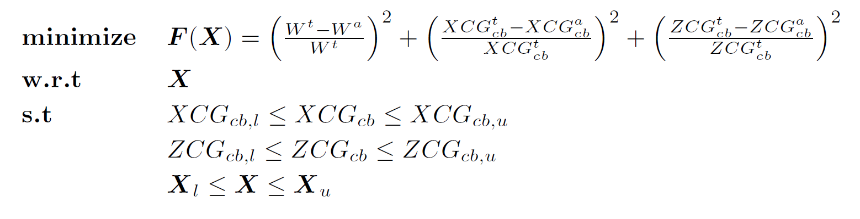
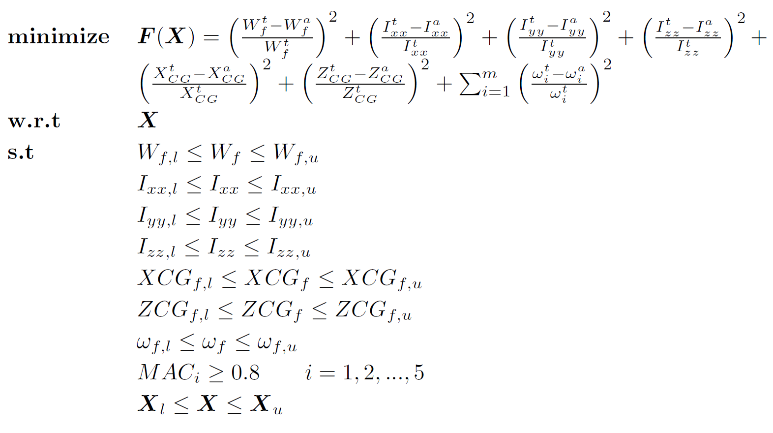
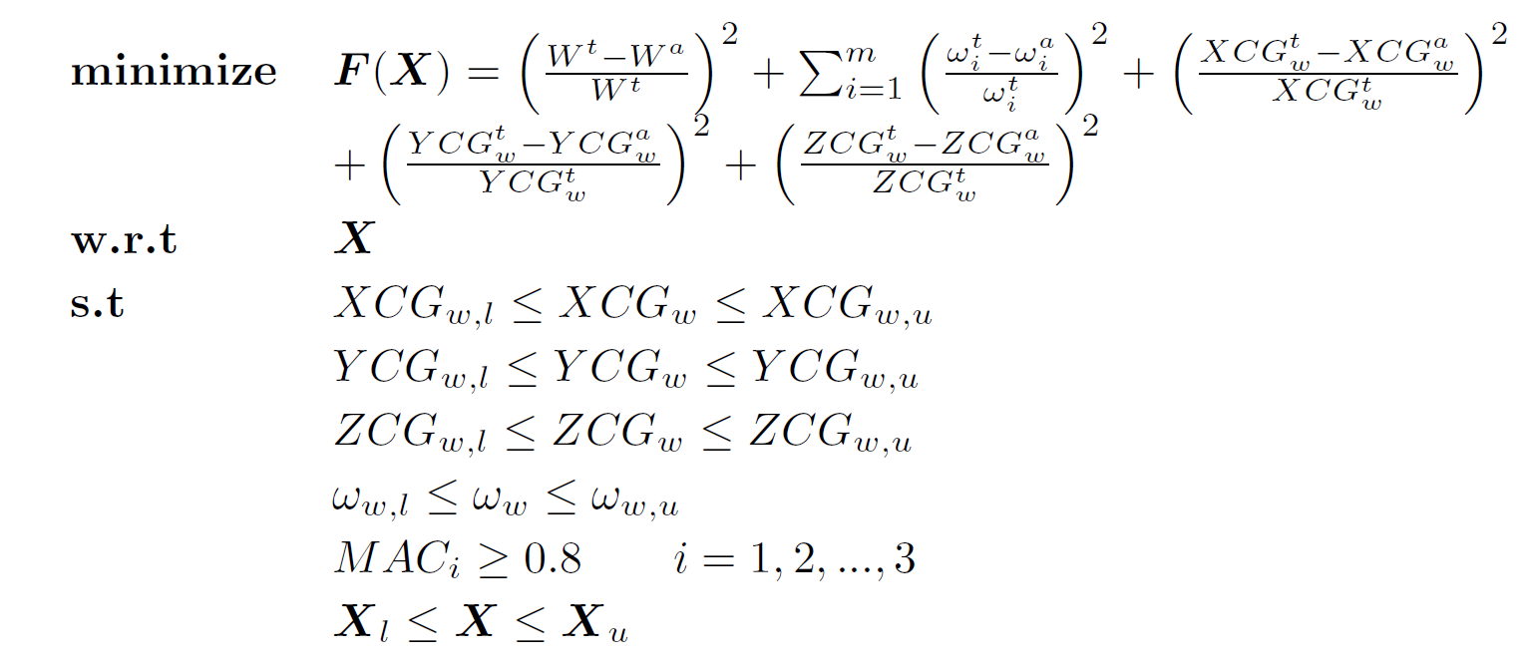
Paper 5 problem formulation
Step I: FEM Updating for Center-body
Step III: FEM Updating for the Full Model
Step II: FEM Updating for Wing

Slide 39
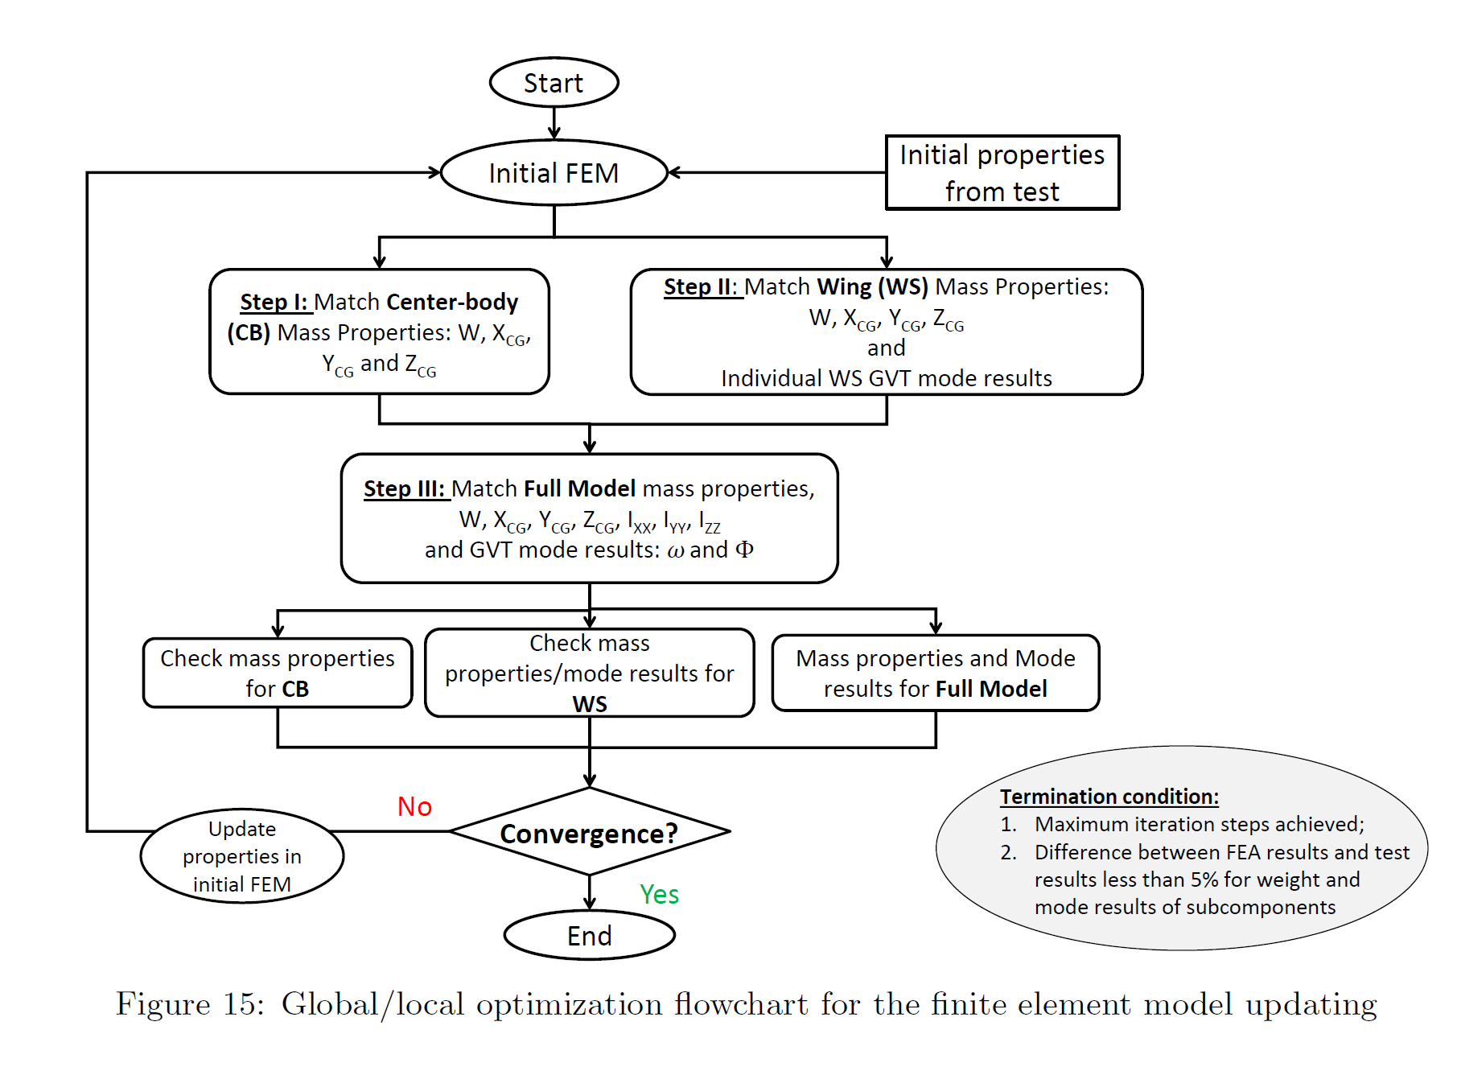
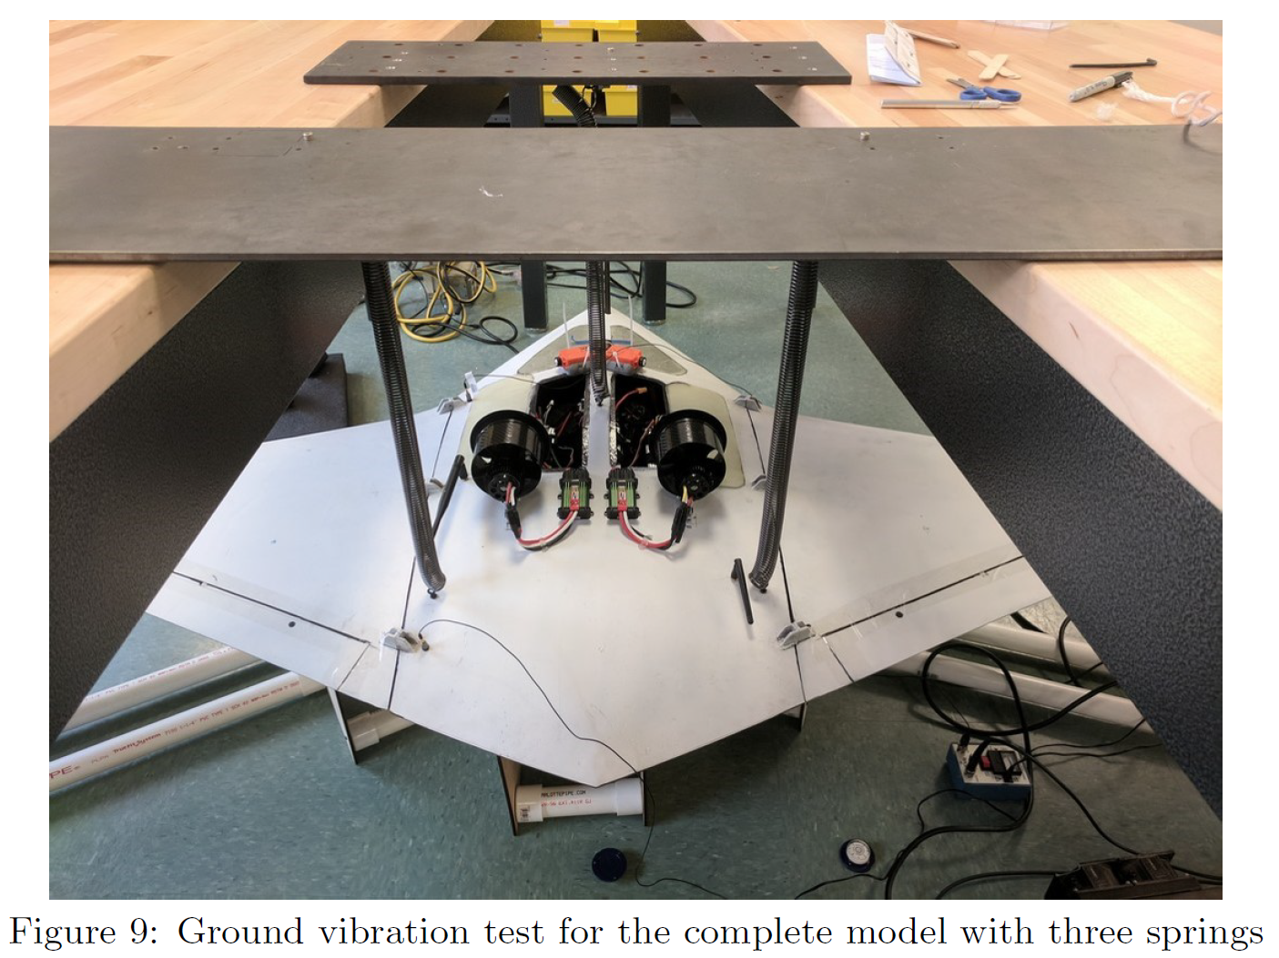
Paper 5 implementation
Note: Swap with picture of design variables

Slide 40
Start
Initial FEM
Modified FEM
Extract frequencies and mode shapes (at undeformed state)
Start
Check inertia properties, frequencies and mode shapes of the updated numerical model against the experimental data (Eq. 1)
GVT data: mode shapes, damping and frequencies (at undeformed state)
Termination criteria:
Maximum number of iterations exceeded
Acceptable match found within tolerance
NO
Convergence
YES
Updated FEM
End

Slide 41
Start
Initial FEM
Modified FEM
Extract frequencies and mode shapes (at each of the n loading conditions)
Start
Initial n loading cases
Check inertia properties, frequencies and mode shapes of the updated numerical model against the experimental data (Eq. 2)
GVT data: mode shapes, damping and frequencies (at each of the n loading conditions)
GVT
Convergence
Exceed max iterations
NO
Increase number of loading cases (n)
Acceptable match found within tolerance
Updated FEM
End

Slide 42
Start
Mistuned Reference FEM
Initial FEM
Modified FEM
Extract frequencies and mode shapes (at each of the n loading conditions)
Start
Initial n loading cases
Check inertia properties, frequencies and mode shapes of the updated numerical model against the experimental data (Eq. 2)
GVT data: mode shapes, damping and frequencies (at each of the n loading conditions)
Reference FEM
Convergence
Exceed max iterations
NO
Increase number of loading cases (n)
Acceptable match found within tolerance
Updated FEM
End

Slide 43
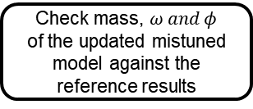
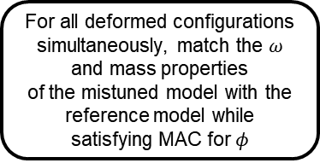
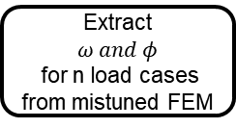
Start
Initial FEM
Modified FEM
Extract
$$ω and φ$$
for n load cases from mistuned FEM
For all deformed configurations simultaneously, match the $ω$ and mass properties
of the mistuned model with the reference model while satisfying MAC for $φ$
Surrogate GVT data
n load cases that cause large deformations
Check mass, $ω and φ$
of the updated mistuned model against the reference results
Termination criteria:
Maximum number of iterations exceeded
Acceptable match found within tolerance
Convergence
NO
Updated FEM
YES
End

Slide 44
Single shot optimization
Start
Initial FEM
GVT data: mode shapes and frequencies
Match frequencies and mass properties, while satisfying MAC for mode shapes
Check mass, frequencies and mode shapes of the updated numerical model against the experimental results
Termination criteria:
Maximum number of iterations exceeded.
Acceptable match found within tolerance
Convergence
NO
YES
End

Slide 45
Single shot optimization -VF
Define n load cases or boundary conditions that cause large deformation in the very flexible test case
Define n load cases or boundary conditions that cause large deformation in the very flexible test case
Start
Initial FEM
GVT data: mode shapes and frequencies in n deformed configurations
GVT data: mode shapes and frequencies in n deformed configurations
For each deformed configuration, match the frequencies and mode shapes
Check mass, frequencies and mode shapes of the updated numerical model against the experimental results
Compare the FEM tuned for different configurations against each other
Termination criteria:
Maximum number of iterations exceeded.
Acceptable match found within tolerance
NO
Convergence
YES
End

Slide 46
Single shot optimization –num only
Define n load cases or boundary conditions that cause large deformation in the very flexible test case
Randomly mistune properties generate mistuned model
Start
Reference FEM
Extract reference values for each load case:
natural frequencies and mode shapes
Data from the mistuned FEM: mode shapes and frequencies in n deformed configurations
For each deformed configuration, match the frequencies and mode shapes of the mistuned model with the reference model
Check mass, frequencies and mode shapes of the updated mistuned model against the reference results
Compare the FEM tuned for different deformed configurations against each other
Recover initial reference FEM?
Termination criteria:
Maximum number of iterations exceeded
Acceptable match found within tolerance
NO
YES
End

Slide 47
Start
Initial FEM
GVT data: mode shapes and frequencies
Match frequencies and mass properties, while satisfying MAC for mode shapes
Check mass, frequencies and mode shapes of the updated numerical model against the experimental results
Convergence
Termination criteria:
Maximum number of iterations exceeded.
Acceptable match found within tolerance
NO
YES
End

Slide 48
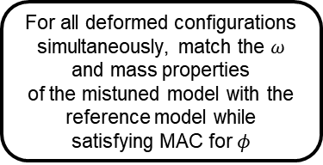



Define n loading conditions that cause large deformation in the very flexible test case
Start
Reference FEM
Generate mistuned model
Extract $ω and φ$
for all load cases from reference FEM
Extract
$$ω and φ$$
for all load cases from mistuned FEM
For all deformed configurations simultaneously, match the $ω$ and mass properties
of the mistuned model with the reference model while satisfying MAC for $φ$
Check mass, $ω and φ$
of the updated mistuned model against the reference results
Termination criteria:
Maximum number of iterations exceeded
Acceptable match found within tolerance
NO
Convergence
YES
End

Slide 49

Paper 5 implementation – Journal paper

Slide 50


Paper 5 outcome/conclusion
Once updated, the FEM was tested to verify if the tuned model’s FRF matched the experimental data (visual comparison)
Static tests were also performed on the structure and additional comparison made with the updated FEM
The bending slope and torsional angles at the wingtip match with test data within 10% for most load cases.
The large difference for some load cases was attributed to the measurement uncertainty when the bending slopes and twist angles are very small.
For all rigid body mass properties, the difference is less than 5% for the half-wing and full model between the FEM and the measured values

Slide 51
Paper 6 Overview
SOLAR IMPULSE – GROUND VIBRATION TESTING AND FINITE ELEMENT MODEL VALIDATION OF A LIGHTWEIGHT AIRCRAFT
Marc Boeswald, Arne Vollan, Yves Govers, Peter Frei
Note: Add a picture of the structure
Two step GVT
On primary structure – to identify modal parameters of main structural components
Fully assembled vehicle
Described how they needed to account for apparent mass of air surrounding the large structure by creating an aeroelastic model and employing DLM analysis

Slide 52

Paper 6 conclusions
Discussed difficulties in accurate response measurements in GVT of lightweight structures, especially the lower frequencies
Correlation between FEM and aeroelastic model showed aero effects need to be considered
Model ‘tuning’ or updating not performed because physical mass matrix that includes apparent mass effects is not available from the aeroelastic analysis

